Slide 1
SmartShop – E-Commerce Platform

Slide 2

Project Vision (Product Owner)
Vision Statement:
easy-to-use E-commerce platform that enables users to browse products, purchase online, and manage their orders seamlessly
Goals:
User registration & login
Browse products
Shopping cart
Checkout (future)
Admin dashboard
Responsive UI/UX
Business Goals:
- Smooth shopping experience
- Secure login & account management
- Easy product browsing & purchasing
- Admin tools for inventory & sales
Stakeholders:
- Customers
- Admins
- Scrum Team
- Product Owner
- Scrum Master

Slide 3
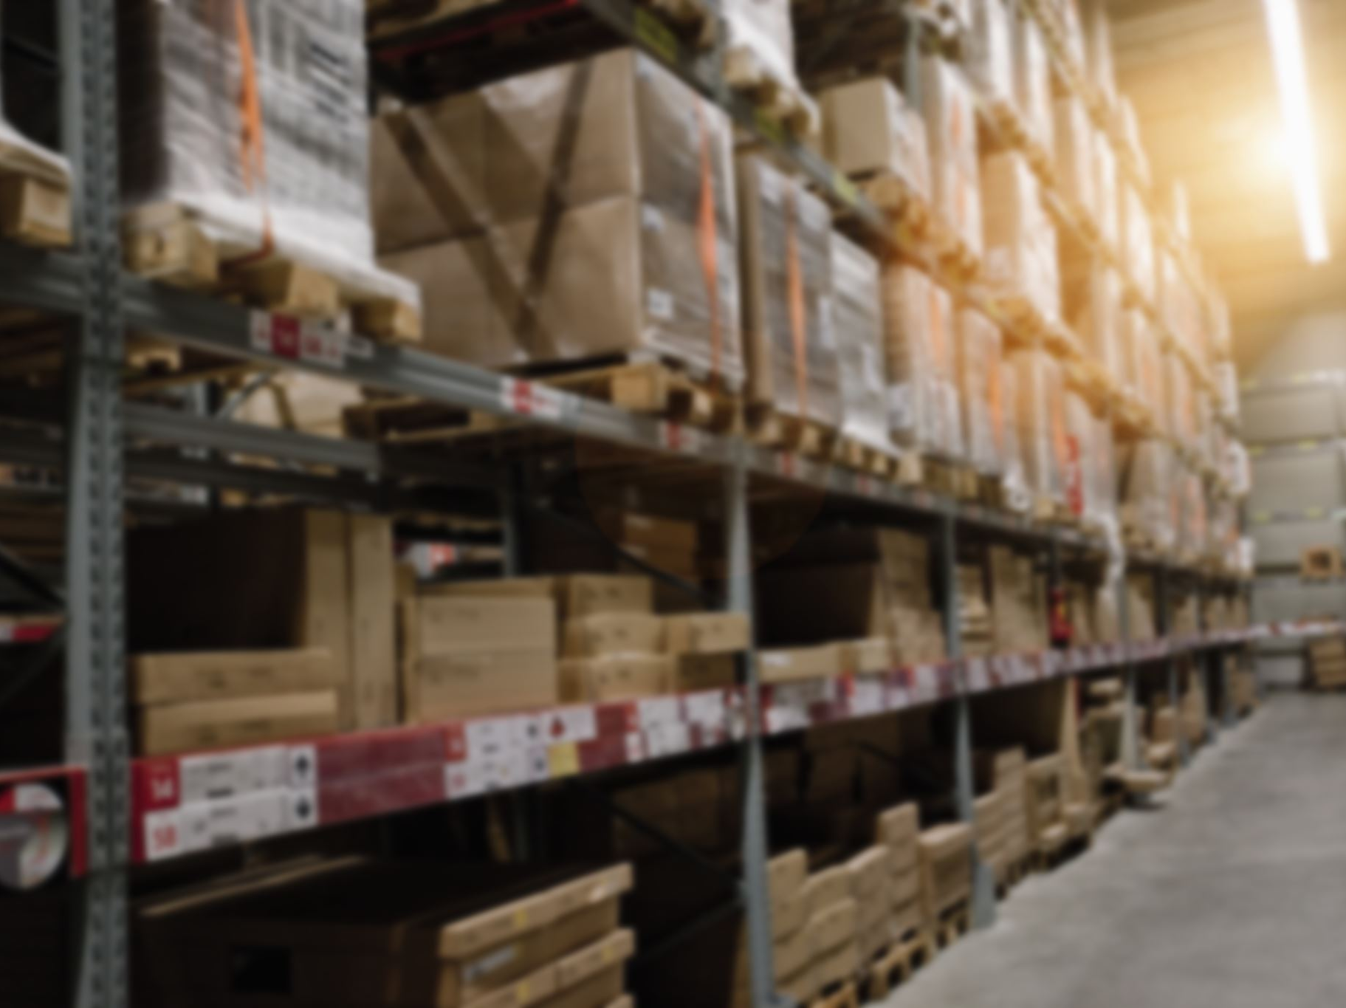
Product Backlog (Product Owner)
US1: Sign Up (Must)
US2: Login (Must)
US3: Browse Products (Must)
US4: Add to Cart (Must)
US5: Search Products (Should)
US6: Checkout (Must)
US7: Track Orders (Should)
US8: Wishlist (Could)
US9: Review Products (Could)
US10: Admin – Add Products (Must)
US11: Admin – Edit Products (Must)
US12: Admin – Delete Products (Must)
US13: Admin – View Sales Reports (Should)

Slide 4
User Story #1
User Story ID | US #1
User Story Name | User Sign-up
Actors | User (Customer)
Description | As a user I’d like to be able to sign up to the application So that I can create an account and access its services
Pre condition | User is not registered
Post condition | A new user account is created in the system. User receives a confirmation message/email.
Acceptance Criteria | Given I’m a new user on the sign-up page When I fill in valid information (email, username, password) and click “Sign Up” Then the system creates my account and shows a confirmation message

Slide 5
User Story #2
User Story ID | US #2
User Story Name | User Login
Actors | User (Customer)
Description | As a user I'd like to be able to login to the application So that I can sign in and access its services
Pre condition | User has an active registered account.
Post condition | User is authenticated and redirected to the homepage/dashboard. Invalid attempts are logged and appropriate error messages displayed
Acceptance Criteria | Given I am a registered user on the login page, When I enter valid credentials, Then I should be successfully logged in and redirected to the homepage. Given I enter invalid credentials, When I attempt to log in, Then the system should reject the login and display an error message.

Slide 6
User Story #3
User Story ID | US #3
User Story Name | Browse Products
Actors | User (Customer)
Description | As a user I’d like to browse products So that I can explore available items
Pre condition | Products are available in the system catalog.
Post condition | Product catalog is displayed with details (name, price, image).
Acceptance Criteria | Given I am on the product catalog page, When I browse the store, Then I should see a list of available products with details (name, price, image). And products should be paginated or scrollable if the list is large.

Slide 7
User Story #4
User Story ID | US #4
User Story Name | User Add to Cart
Actors | User (Customer)
Description | As a customer, I want to add items to my cart so that I can purchase them later.
Pre condition | User is logged in
Post condition | Product is added to cart.
Acceptance Criteria | Given I am on a product page, When I click "Add to Cart", Then the product is added to my cart.

Slide 8
User Story #5
User Story ID | US #5
User Story Name | User Search Products
Actors | User (Customer)
Description | As a customer I’d like to be able to search products So that I can quickly find what I need.
Pre condition | Products exist in catalog.
Post condition | Search results are displayed.
Acceptance Criteria | Given I am on the catalog page When I enter a search keyword Then products matching the query are displayed.

Slide 9
User Story #6
User Story ID | US #6
User Story Name | Checkout
Actors | User (Customer)
Description | As a customer I’d like to be able to checkout So that I can complete my purchase.
Pre condition | User has items in cart.
Post condition | Order is placed successfully.
Acceptance Criteria | Given I have items in my cart When I proceed to checkout and provide shipping/payment details Then my order is confirmed.

Slide 10
User Story #7
User Story ID | US #7
User Story Name | User Track Orders
Actors | User (Customer)
Description | As a customer I’d like to be able to track my orders So that I can monitor delivery progress
Pre condition | User has placed an order
Post condition | Order status is displayed.
Acceptance Criteria | Given I have placed an order When I visit "My Orders" Then I should see the current status (processing, shipped, delivered).

Slide 11
User Story #8
User Story ID | US #8
User Story Name | User Wishlist
Actors | User (Customer)
Description | As a customer I’d like to be able to add products to a wishlist So that I can save them for later.
Pre condition | User is browsing products. User is logged in
Post condition | Item is stored in wishlist.
Acceptance Criteria | Given I am browsing products When I click "Add to Wishlist" Then the product is saved to my wishlist.

Slide 12
User Story #9
User Story ID | US #9
User Story Name | User Review Products
Actors | User (Customer)
Description | As a customer I’d like to be able to review products So that I can share my experience with others.
Pre condition | User has purchased a product.
Post condition | Review is visible on product page.
Acceptance Criteria | Given purchased a product When I submit a review with text/rating Then tit is displayed on the product page.

Slide 13
User Story #10
User Story ID | US #10
User Story Name | Admin Add Products
Actors | Admin
Description | As an admin I’d like to be able to add products So that hey appear in the catalog
Pre condition | Admin is logged in.
Post condition | New product is added to catalog.
Acceptance Criteria | Given I am an admin When I enter product details (name, price, stock, image), Then the product is added to catalog.

Slide 14
User Story #11
User Story ID | US #11
User Story Name | Admin Edit Products
Actors | Admin
Description | As an admin I’d like to be able to edit products So that catalog details are updated
Pre condition | Product exists in catalog
Post condition | Product details are updated.
Acceptance Criteria | Given I am an admin When I update product details Then the changes are saved and reflected in catalog.

Slide 15
User Story #12
User Story ID | US #12
User Story Name | Admin Delete Products
Actors | Admin
Description | As an admin I’d like to be able to delete products So that unavailable items are removed
Pre condition | Product exists in catalog.
Post condition | Product is removed from catalog.
Acceptance Criteria | Given I am an admin When I delete a product Then it is removed from the catalog.

Slide 16
User Story #13
User Story ID | US #13
User Story Name | Admin View Sales Reports
Actors | Admin
Description | As an admin I’d like to be able to view sales reports So that I can analyze business performance
Pre condition
Post condition | Reports are generated and displayed.
Acceptance Criteria | Given I am an admin When I access the reports dashboard Then I can view sales statistics (orders, revenue, best-selling products).

Slide 17

Sprint 1 Goal
Sprint Goal: Deliver entry point for users (Sign Up, Login, Browse Products)
Selected User Stories:
- US1: Sign Up
- US2: Login
- US3: Browse Products

Slide 18
User Registration
User Story ID | US #1
User Story Name | User Sign-up
Actors | User (Customer)
Description | As a user I’d like to be able to sign up to the application So that I can create an account and access its services
Pre condition | User is not registered
Post condition | A new user account is created in the system. User receives a confirmation message/email.
Acceptance Criteria | Given I’m a new user on the sign-up page When I fill in valid information (email, username, password) and click “Sign Up” Then the system creates my account and shows a confirmation message

Slide 19
Main Success Scenario: User Registration
User navigates to the registration page
System displays sign-up form with fields: Email, Username, Password, Confirm Password
User enters valid information in all fields
User clicks "Sign Up" button
System validates that email is not already registered
System validates that password meets security requirements
System creates new user account in database
System sends confirmation email to user
System displays success message: "Account created successfully!"
System redirects user to login page

Slide 20
Alternative Flow : Email Already Exists
User navigates to the Registration Page.
System displays the Sign-Up Form.
User enters information including an already registered email.
User clicks the "Sign Up" button.
System checks and finds the email already exists.
System displays error message: "This email is already in use. Please log in or use a different email.“
User remains on the registration page.

Slide 21
Alternative Flow : Invalid Password Format
User navigates to the Registration Page.
System displays the Sign-Up Form.
User enters information with an invalid password format.
User clicks the "Sign Up" button.
System validates the password and finds it does not meet security requirements.
System displays password rules (e.g., minimum length, special characters, etc.).
User re-enters a valid password.

Slide 22
Alternative Flow : Required Fields Missing
User navigates to the Registration Page.
System displays the Sign-Up Form.
User leaves one or more required fields empty.
User clicks the "Sign Up" button.
System checks the input and detects missing mandatory fields.
System highlights the missing fields and displays error message: "Please fill in all required fields."
User completes the form and resubmits.

Slide 23
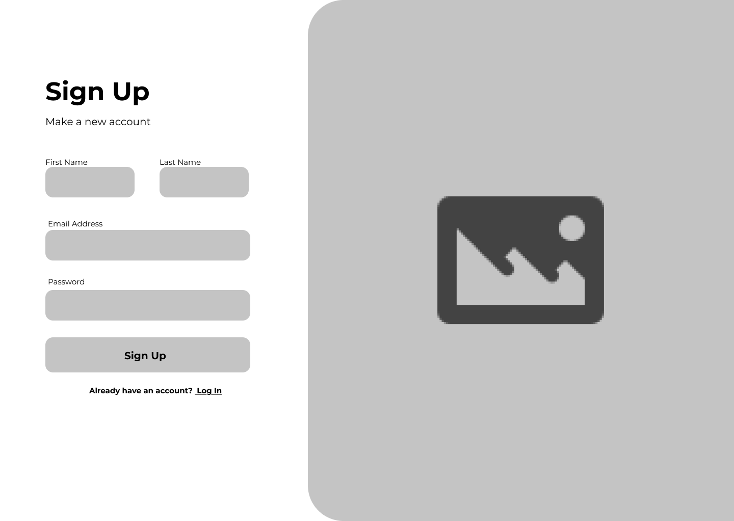

Slide 24
User Story #2
User Story ID | US #2
User Story Name | User Login
Actors | User (Customer)
Description | As a user I'd like to be able to login to the application So that I can sign in and access its services
Pre condition | User has an active registered account.
Post condition | User is authenticated and redirected to the homepage/dashboard. Invalid attempts are logged and appropriate error messages displayed
Acceptance Criteria | Given I am a registered user on the login page, When I enter valid credentials, Then I should be successfully logged in and redirected to the homepage. Given I enter invalid credentials, When I attempt to log in, Then the system should reject the login and display an error message.

Slide 25
Main Success Scenario: User Login
User navigates to login page
System displays login form with Email/Username and Password fields
User enters registered credentials
User clicks "Login" button
System validates credentials against user database
System creates user session
System logs the login activity
System redirects user to homepage/dashboard

Slide 26
Alternative Flow : Invalid Credentials
User navigates to the Login Page.
System displays the Login Form.
User enters incorrect email/username or password.
User clicks the "Login" button.
System validates the credentials and finds them invalid.
System displays error message: "Invalid credentials. Please try again."
User remains on the login page.

Slide 27
Alternative Flow : Forgot Password
User navigates to the Login Page.
System displays the Login Form.
User clicks the "Forgot Password" link.
System initiates the password reset flow
(e.g., sends a password reset email with instructions).

Slide 28
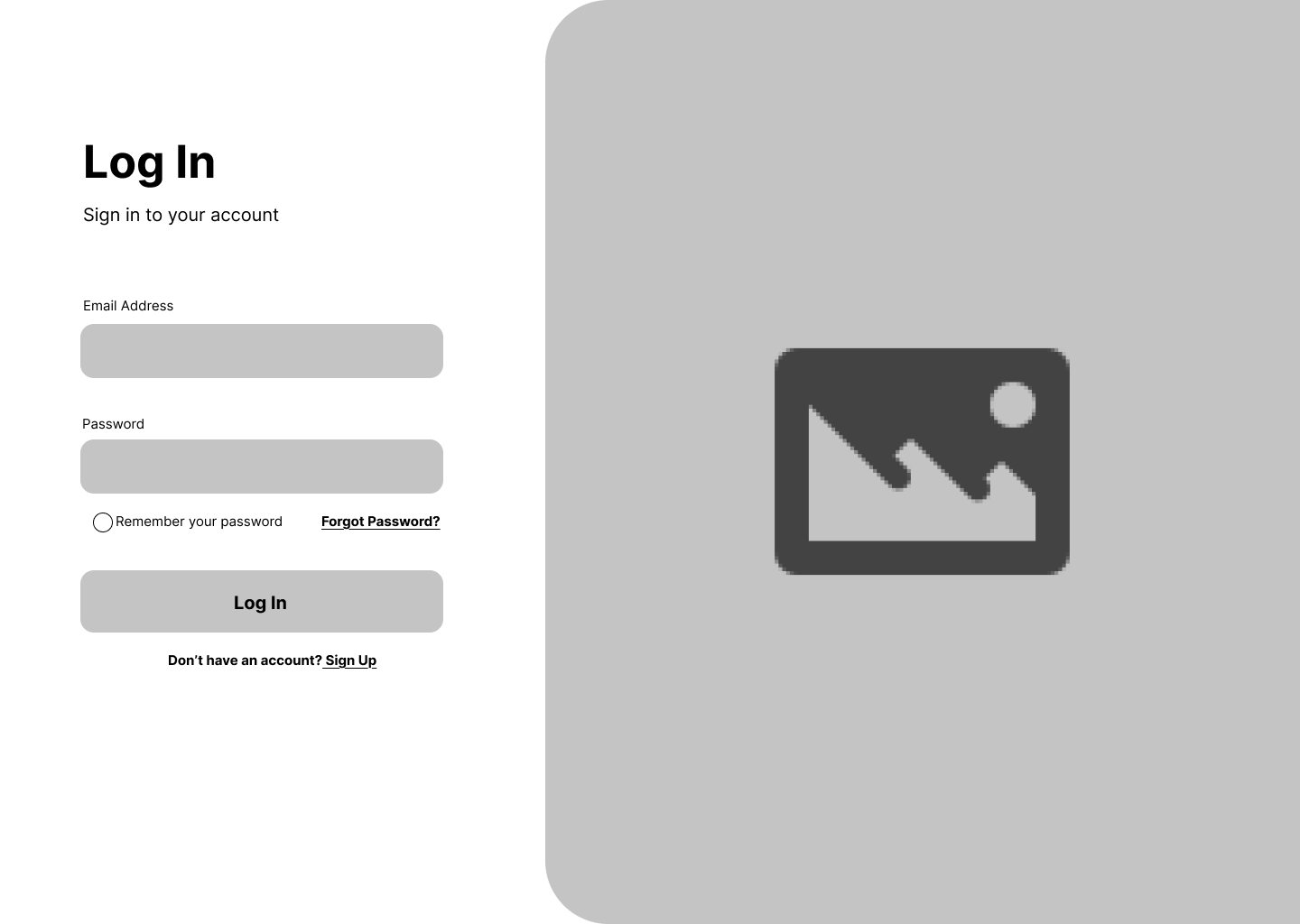

Slide 29
User Story #3
User Story ID | US #3
User Story Name | Browse Products
Actors | User (Customer)
Description | As a user I’d like to browse products So that I can explore available items
Pre condition | Products are available in the system catalog.
Post condition | Product catalog is displayed with details (name, price, image).
Acceptance Criteria | Given I am on the product catalog page, When I browse the store, Then I should see a list of available products with details (name, price, image). And products should be paginated or scrollable if the list is large.

Slide 30
Main Success Scenario: Browse Product Catalog
User accesses product catalog page
System retrieves available products from database
System displays product grid with: Image, Name, Price, "Add to Cart" button
User scrolls or paginates through product list
User clicks on a product to view details
System displays product detail page

Slide 31
Alternative Flow : Filter by Category
User accesses the Product Catalog Page.
System displays the list of available products.
User selects a category filter (e.g., Electronics, Clothing, Books).
System retrieves products that match the selected category.
System updates and displays the filtered product grid.

Slide 32
Alternative Flow : Sort Products
User accesses the Product Catalog Page.
System displays the list of available products.
User selects a sorting option (e.g., by Price, Popularity, or Newest).
System reorders the products based on the selected sorting criteria.
System displays the sorted product grid.

Slide 33
Alternative Flow : No Products Available
User accesses the Product Catalog Page.
System queries the database for available products.
System detects that no products are available (e.g., out of stock or category empty).
System displays an empty state message:
"No products available at the moment. Please check back later."

Slide 34
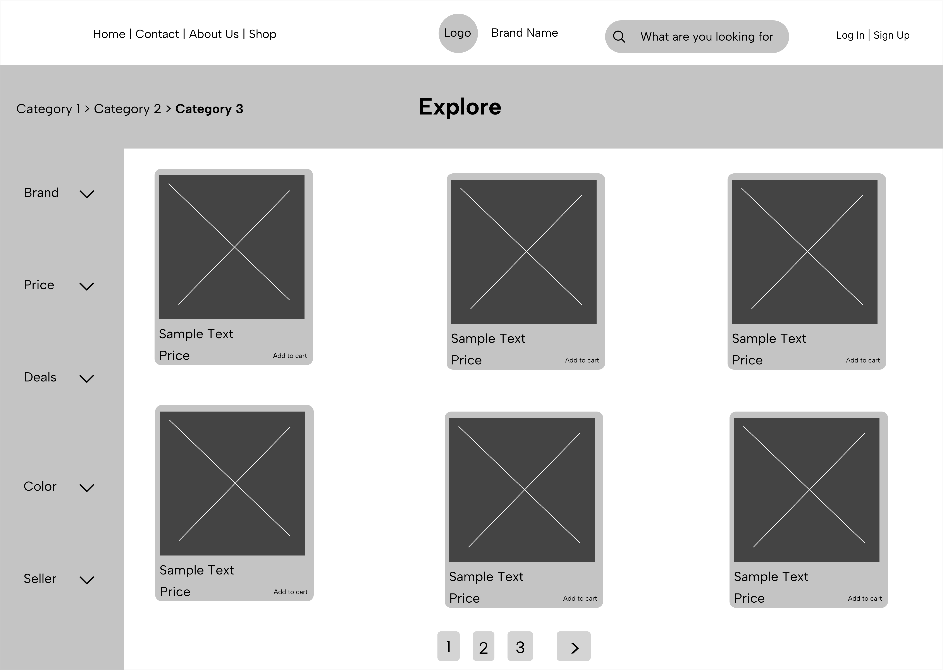

Slide 35
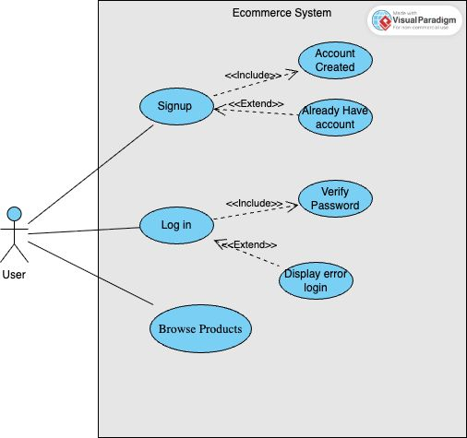
Use Case Diagram (Analysis Lead)
Actors: Customer
Use Cases: Sign Up, Login, Browse Products

Slide 36
Wireframes / Mockups (UI/UX Lead)
Screens:
- Sign Up Page
- Login Page
- Browse Products Page
(Add mockup images here)

Slide 37
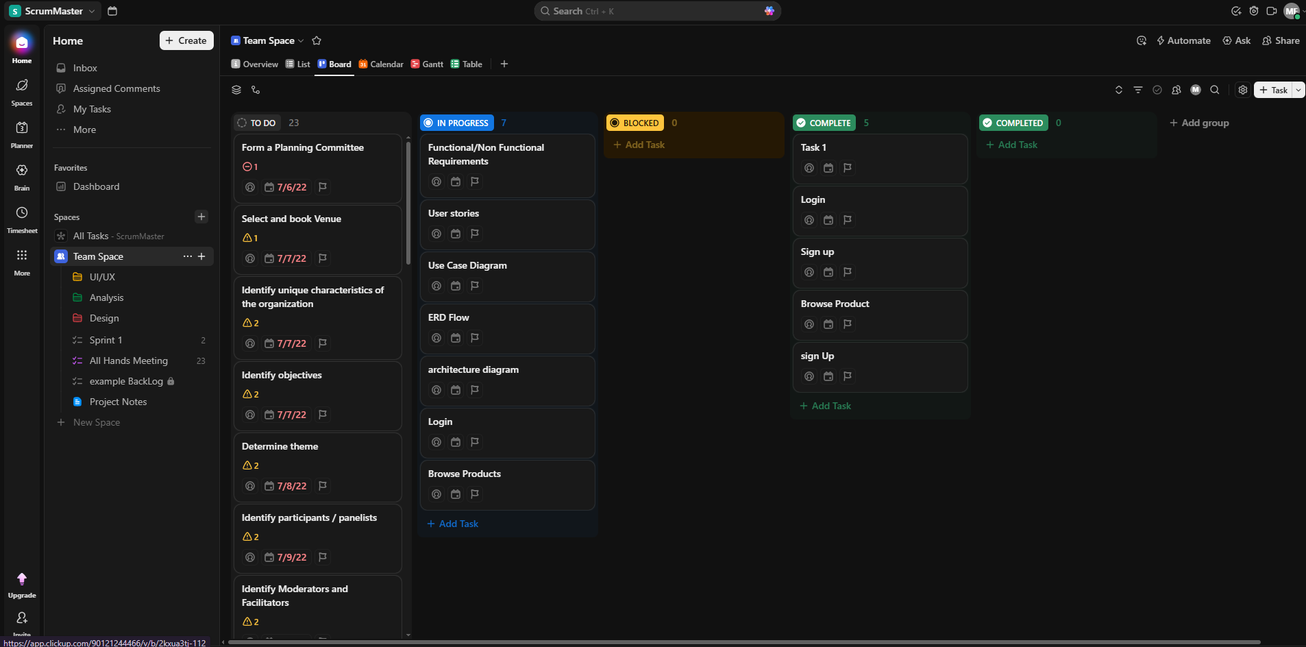
Click Up
Add screenshot of Scrum/clickUp
Tasks for US1, US2, US3

Slide 38
Definition of Done (Team Agreement)
A user story is 'Done' when:
Implemented(use case)
- Implemented (UI/Mockup)
- Acceptance criteria met
- Approved by Product Owner

Slide 39
Conclusion (Team)
Sprint 1 delivered:
- Sign Up
- Login
- Browse Products
This establishes foundation for Sprint 2 (Cart, Checkout, Search).

Slide 40
Release Plan
Release | Features / Deliverables
Release 1 | User Registration, Login, Browse Products
Release 2 | Wishlist, Search Products, Add to Cart
Release 3 | Track Orders,Review Products, Checkout
Release 4 | Admin Management (Add/Edit/Delete Products, View Reports)

